Slide 1

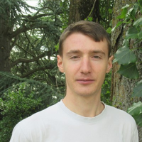
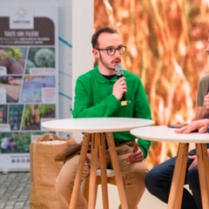



Can AI accurately predict forage energy and protein values using chemical and textual data ?
Aristide Lauront, Matéo Petitet, Raphaël Genin et Raphaël Rubrice
A project of the Association Française de Zootechnie (AFZ)
Supervised by Valérie Heuzé and Gilles Tran
1

Slide 2
Challenge : predicting forage value
Ration composition :
  impacts yield & economic revenue
  impacts animal health and welfare
  shall maximize quality/price ratio
French National Institute of Agricultural and Environmental Research (INRAE) helped develop nutrition system based on energy and protein intakes.
Why ?
For what purpose ?
  high variability
  right calculation is convoluted
  forage description might be complex
  creation of ration on the fly
  precise monitoring of nutrient and energy supply
2

Slide 3
Focus on predictors - Labels (1)
5 levels of semi-structured textual data
General
Specific
ID | Label 0 | Label 1 | Label 2 | Label 3 | Label 4
FV0230 | FOURRAGES VERTS | PRAIRIES PERMANENTES, MONTAGNE (ALPES NORD) | À base de graminées | 1er cycle | Épiaison du dactyle
FE0490 | ENSILAGES | PRAIRIES PERMANENTES, PLAINE (NORMANDIE) | Préfané coupe fine | 1er cycle | 15-25 mai, début épiaison, ST = 470°C
FF0910 | FOINS | GRAMINÉES FOURRAGÈRES, RAY-GRASS D'ITALIE, ALTERNATIF | Ventilé | 1er cycle | Épi à 10 cm du sol
From level 0 to level 2 labels are consistent, above level two they are a lot more random
3

Slide 4
Type of data available (2)
Data from INRAE describing hundreds of forages characteristics. Each row made of :
ID | DM | Ashes | MAT | CF | NDF | ADF | EE | UFL | UFV | PDIA | PDI | BPR
FV0230 | 21,0 | 80 | 118 | 307 | 581 | 331 | 24 | 0,81 | 0,74 | 28 | 79 | -10
FE0490 | 19,7 | 108 | 182 | 318 | 460 | 330 | 38 | 0,82 | 0,75 | 27 | 74 | 58
FF0910 | 85 | 130 | 219 | 234 | 532 | 271 | 38 | 0,96 | 0,93 | 51 | 104 | 65
Chemical values
6 chemical values taken in laboratory
Nutritional values
4

Slide 5

Focus on predicted values
Calculated/defined by INRAE nutrition system
Energy | Protein
UFL : energy available for milking purpose (1 UFL = 1700 kcal) | PDI : Digestible proteins in the gut, nitrogen nutrient values (metabolizable proteins) in ruminants
UFV : energy available for cattle fattening (1 UFL = 1820 kcal) | PDIA : PDI of food origin, not degraded in the rumen
UFV : energy available for cattle fattening (1 UFL = 1820 kcal) | BPR : protein balance of the rumen
5

Slide 6
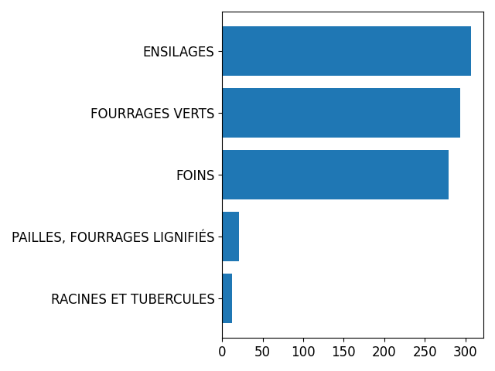
Forage types
Number of samples
6

Slide 7
Tested approaches
  First approach - Machine learning
  Second approach - LLM based
7

Slide 8

First approach - Machine learning
Vectorial representation
OneHot Encoding
Forage description
(0, 1, ..., 0,0)
Splitting
GRASS FORAGE
Dimension reduction
FAMD/ACM
HAY
(0, 1, ..., 0,0)
Labels
ML Model
UFL
Standard Scaler
KNN Imputer
Chemical values
8

Slide 9


Second approach - LLM based
Forage description
Vectorial Embedding
LLM
Neural Net
Predicted values
^
y
Chemical values
Preprocess
9

Slide 10
LLM - Model trained
BERT
CamemBERTaV2
Finetuning
BERT
CamemBERTaV2
BERT R
CamemBERTaV2 R
Hyperparameter optimization
“basic”
“best
non FT
FT
non FT
FT
BERT
CamemBERTaV2
BERT R
CamemBERTaV2 R
BERT
CamemBERTaV2
BERT R
CamemBERTaV2 R
10

Slide 11
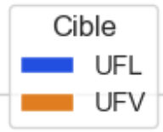
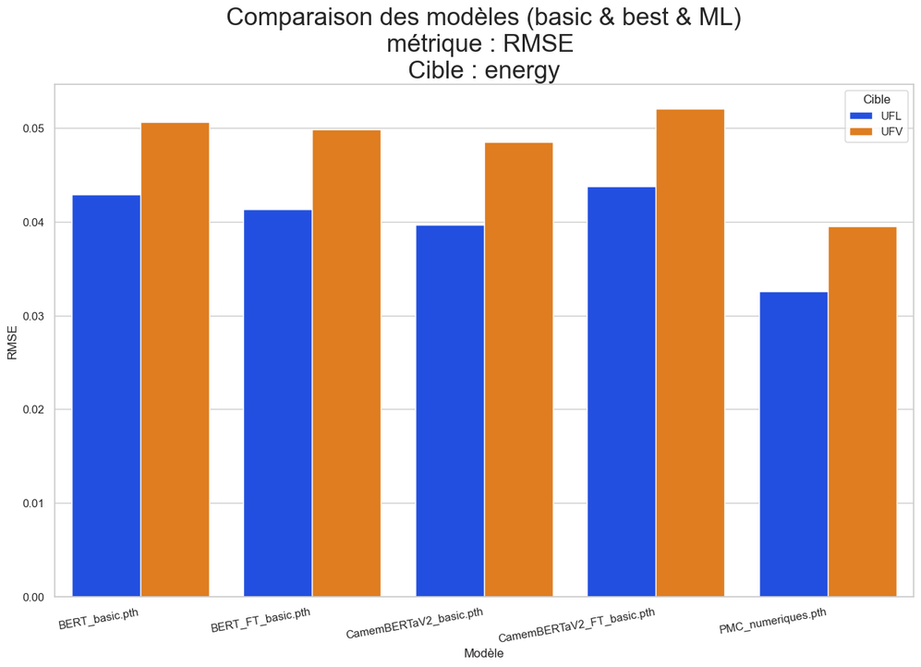
Apprent
Results - Energy values
0.05
0.04
0.03
RMSE
0.02
0.01
0.00
---------- BERT -------------
----CamenBERTa ----
Chemical only
11

Slide 12
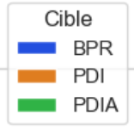
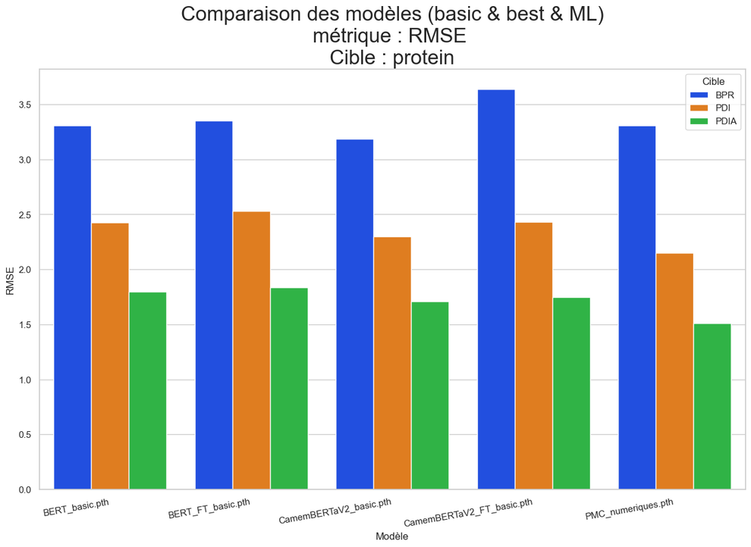
Apprent
Results - Protein values
3.5
3.0
2.5
2.0
RMSE
1.5
1.0
0.5
0.0
----------- BERT ------------
--------CamenBERTa--------
Chemical only
12

Slide 13
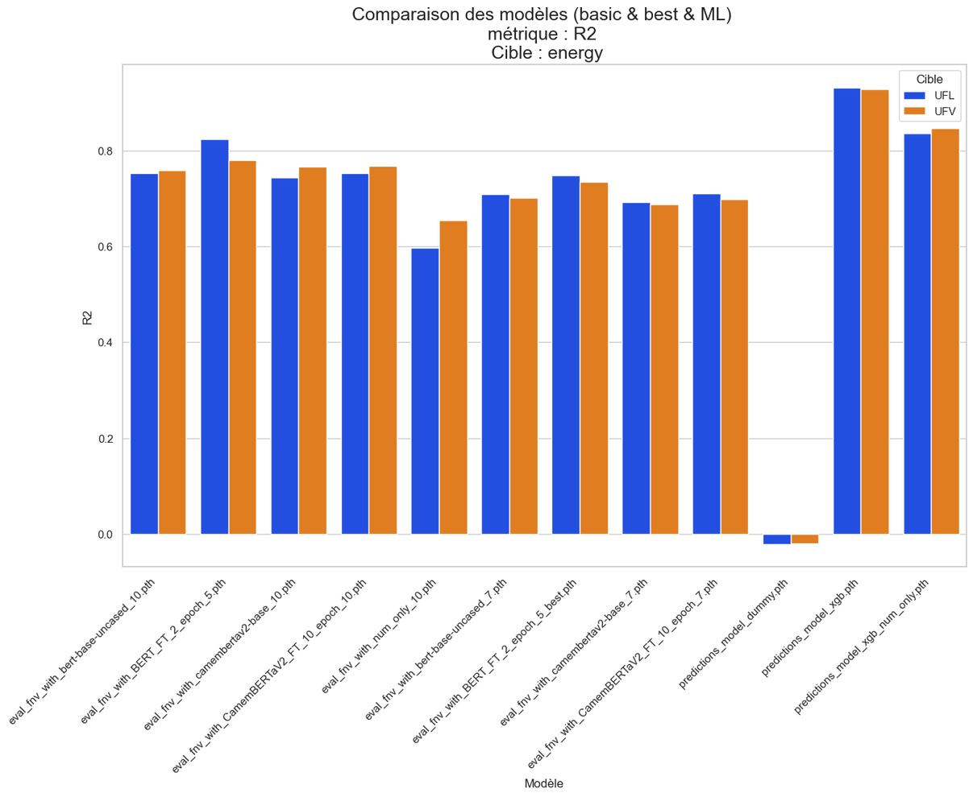
Results - Energy values
1.0
0.8
0.6
R²
0.4
0.2
0.0
LLM-based
non-neural
13

Slide 14
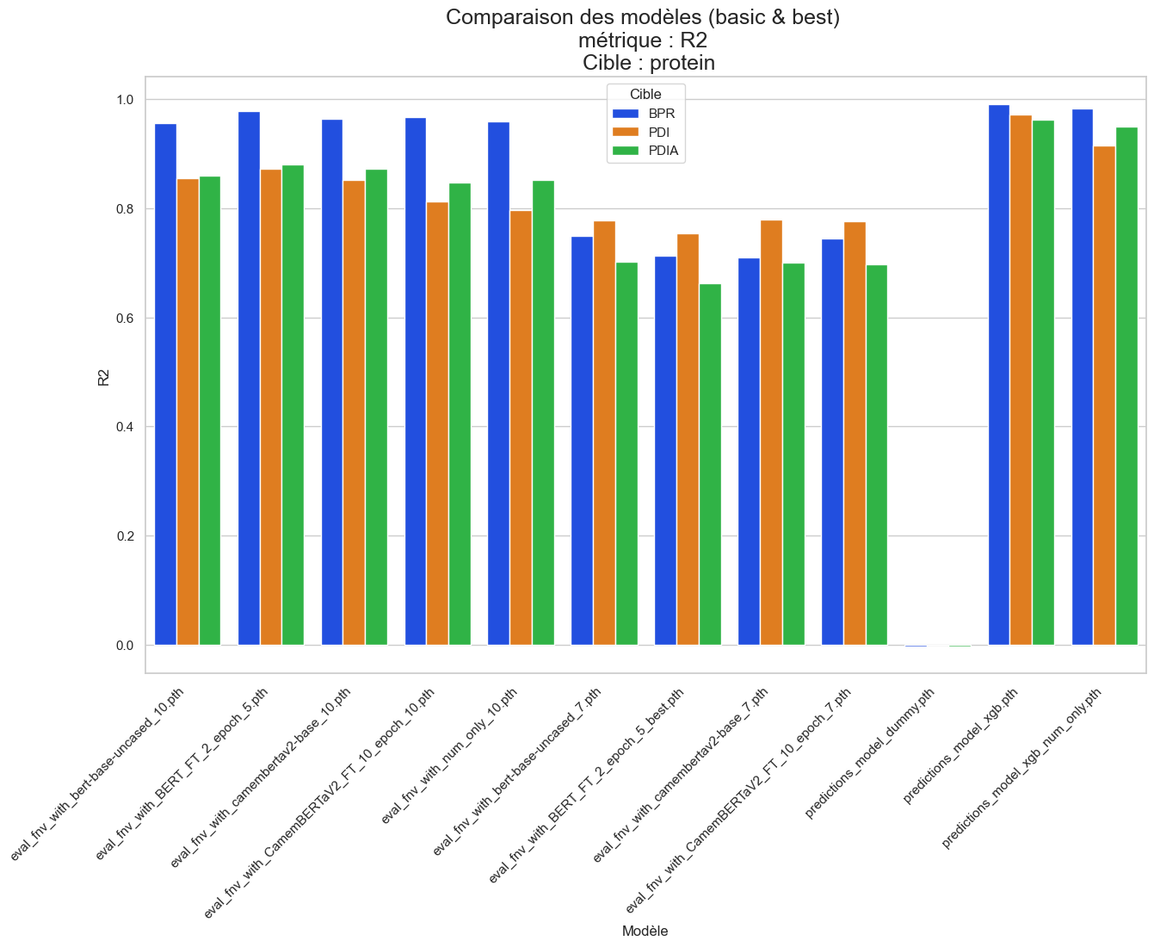
Results - Protein values
1.0
0.8
0.6
R²
0.4
0.2
0.0
LLM-based
non-neural
14

Slide 15
Key Takeaways
  Promising results for predicting all targets
  Best model : non-neural approach (XGBoost)
  Deep learning models with contrasting results:
    comparable or slightly better results than non-neural
    better generalization capacity
    higher inference and training costs
  Prospects: field experimentation, use with routine systems, generalization to other fields
15

Slide 16
ADDITIONAL MATERIAL

Slide 17
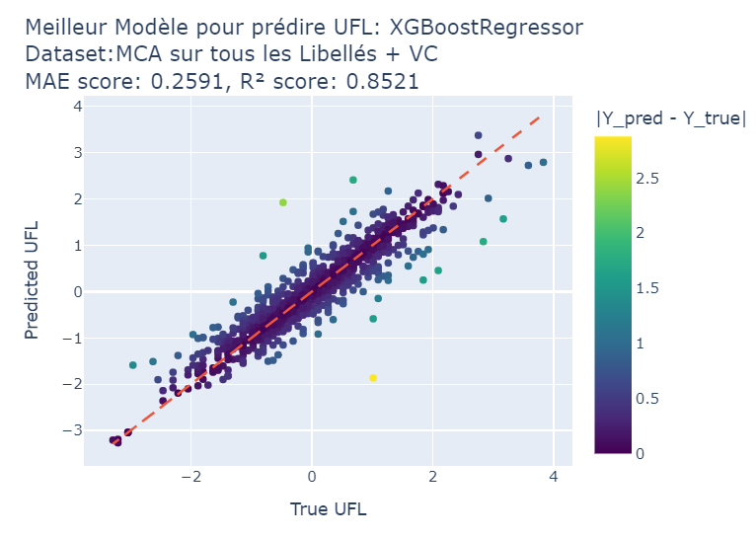
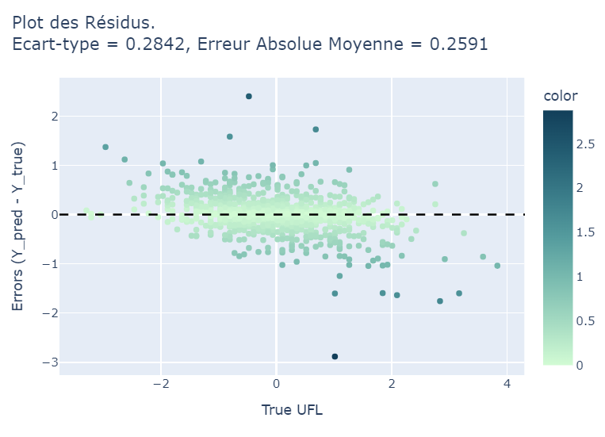
Best model – non neural UFL
a

Slide 18
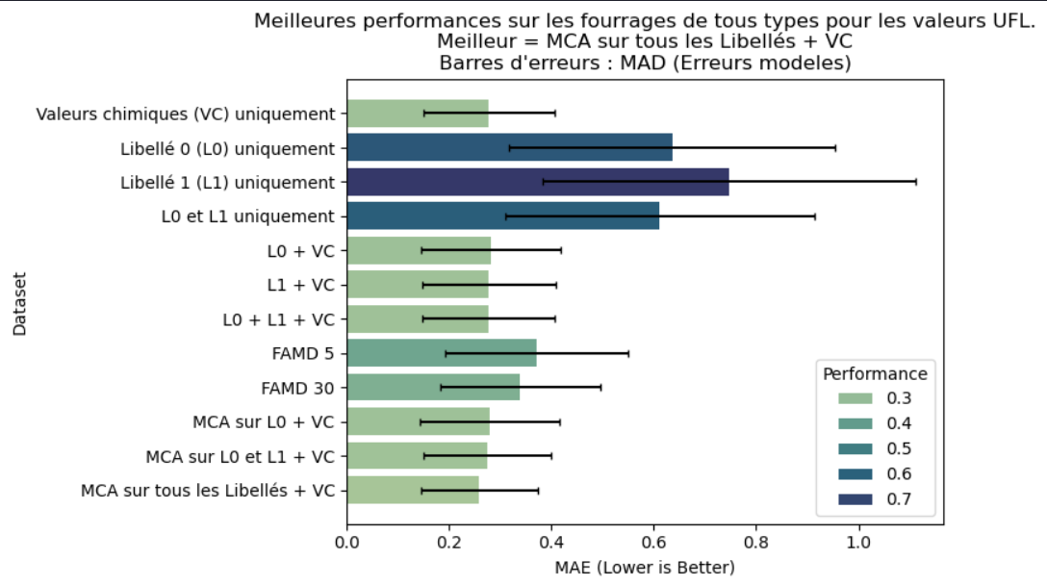
Non neural
Pre-process ?
UFL
b

